Slide 1
Basics of Digital Communication
UNIT -1

Slide 2
1)Introduction to digital communication
Communication means sharing of information.
This sharing can be local or remote .Between individuals local communication usually occurs face to face, while remote communication takes place over distance.
The term telecommunication ,which includes telephony ,telegraphy ,and television ,means communication at a distance.
The word data refers to information presented in what ever form is agreed upon by the parties creating and using data.

Slide 3
Data communication are the exchange of data between two devices via some form of transmission medium such as a wire cable.
For data communications to occur ,the communicating devices must be part of a communication system made up of a combination of hardware and software.
The effectiveness of a data communications system depends on four fundamental characteristics : Delivery ,Accuracy ,Timeliness and Jitter.

Slide 4
Delivery : The system must deliver data to the correct destination .Data must be received by the intended device or user and only by that device or user.
Accuracy : The system must deliver the data accurately .Data that have been altered in transmission and left uncorrected are unusable.
Timeliness :The system must deliver data in a timely manner .Data delivered late are useless .
Jitter : Jitter refers to the variation in the packet arrival time.

Slide 5
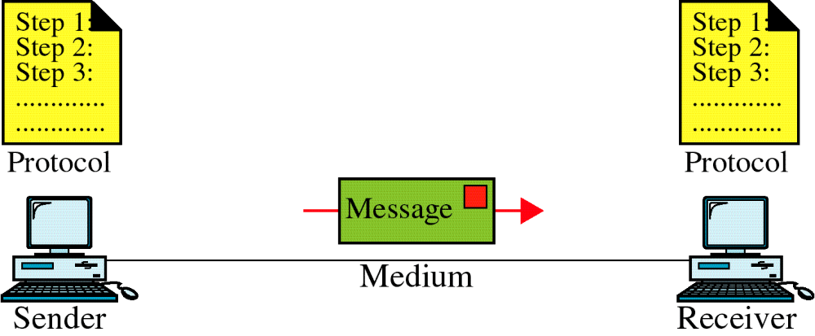
A data communication system has five components

Slide 6
Message :The message is the information or data to be communicated
Sender : The sender is the device that sends the message .It can be a computer ,workstation ,telephone handset ,video camera and so on.
Receiver : The receiver is the device that receives the message .It can be a computer ,workstation ,telephone handset ,television ,and so on.
Transmission medium : Transmission medium is the physical path by which a message travels from sender to receiver .Examples are twisted-pair wire ,coaxial cable ,fiber-optic cable ,and radio waves.

Slide 7
Protocol : Protocol is a set of rules that govern data communications .It represents an agreement between the communicating devices .Without a protocol, two devices may be connected but not communicating ,just as a person speaking French can not be understood by a person who speaks only Japanese.
Data representation
Information today comes in different forms such as text ,numbers ,images ,audio and video.

Slide 8
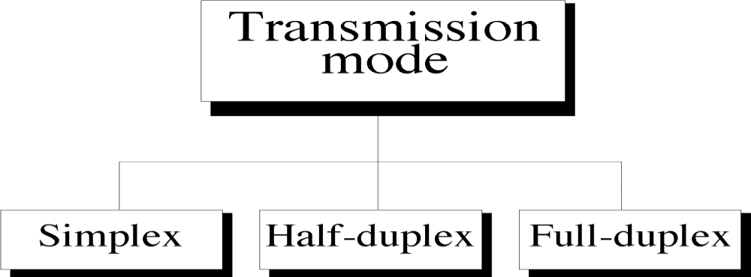
2)Modes of communication
Communication between two devices can be simplex ,half-duplex or full-duplex.

Slide 9
Simplex : In simplex mode ,the communication is unidirectional as on a one way street .Only one of the two devices on a link can transmit ,the other can only receive.
Example: Keyboard and traditional monitors .The keyboard can only introduce input ,the monitor can only accept output. The simplex mode can use the entire capacity of the channel to send data in one direction.

Slide 10
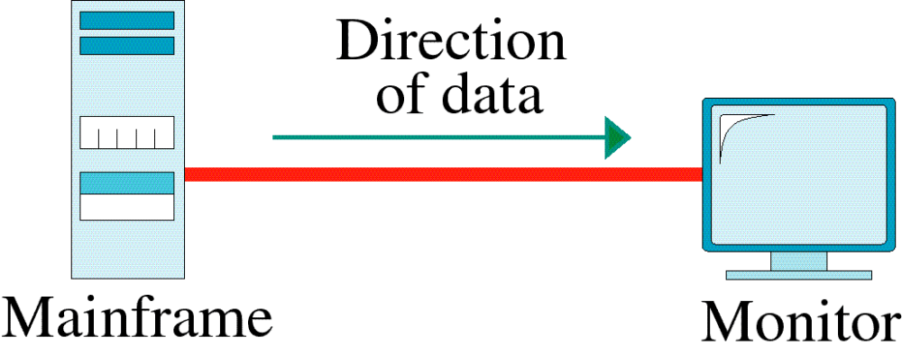
Figure : Simplex

Slide 11
Half-Duplex : In half-duplex mode ,each station can both transmit and receive ,but not at the same time. When one device is sending ,the other can only receive ,and vice versa.
Example : The half-duplex mode is like a one-lane road with traffic allowed in both directions .When cars travelling in one direction ,cars going the other way must wait.
In a half-duplex transmission ,the entire capacity of the channel is taken over by whichever of the two devices is transmitting at the time.
Walkie –talkie is a half-duplex system

Slide 12

Figure : Half-Duplex

Slide 13
Full-Duplex : In full-duplex mode also called duplex ,both stations can transmit and receive simultaneously.
The full duplex mode is like a two-way street with traffic flowing in both directions at the same time .In full-duplex mode ,signals going in one direction share the capacity of the link with signals going in the other direction.
This sharing can occur in two ways .Either the link must contain two physically separate transmission paths ,one for sending and the other for receiving ,or the capacity of the channel is divided between signals travelling in both directions.
One common example of full-duplex communication is the telephone network .When two people are communicating by a telephone line ,both can talk and listen at the same time.

Slide 14
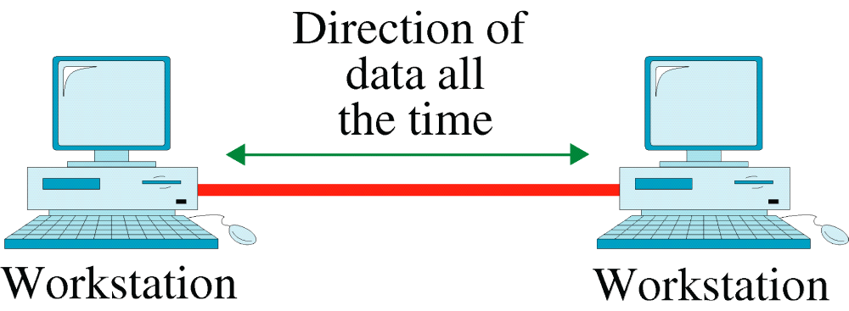
Figure : Full-Duplex

Slide 15
3) Concepts of Data Transmission : Signal Propagation
To be transmitted ,data must be transformed into electromagnetic signals.
Both data and the signals that represent them can be either analog or digital in form.
Analog and Digital data
Data can be analog or digital .The term analog data refers to information that is continuous, digital data refers to information that has discrete states .

Slide 16
Example
Analog data such as the sounds made by a human voice , takes on continuous values .when someone speaks ,an analog wave is created in the air .This can be captured by a microphone and converted to an analog signal or sampled and converted to a digital signal.
Digital data takes on discrete values .For example ,data are stored in a computer memory in the form of 0s and 1s. They can be converted to a digital signal or modulated in to an analog signal for transmission across a medium.

Slide 17
4) Signal Types : Analog and Digital signals
Like data ,signals can be either analog or digital
An analog signal has infinitely many levels of intensity over a period of time .As the wave moves from value A to value B ,it passes through and includes an infinite number of values along its path.
A digital signal can have only a limited number of defined values .Although each value can be any number ,it is often as simple as 1 and 0.

Slide 18
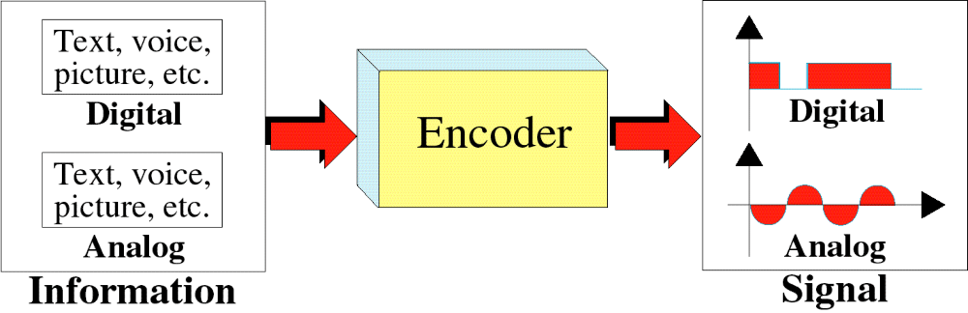
Figure : Transformation of information to signals

Slide 19
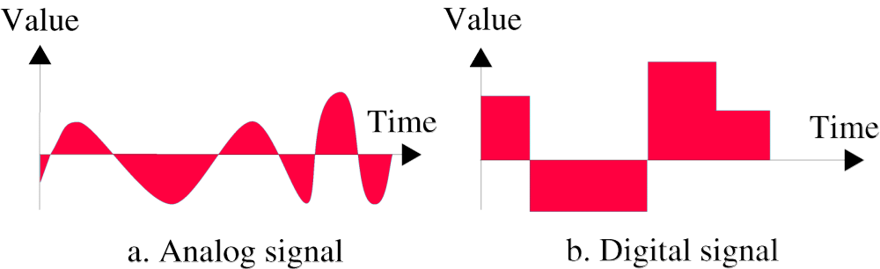
Figure : Comparison of analog and digital signals

Slide 20
Periodic and Non-periodic signals
Both analog and digital signals can take one of two forms :periodic or non-periodic.
A periodic signal completes a pattern within a measurable time frame ,called a period ,and repeats that pattern over subsequent identical periods .The completion of one full pattern is called a cycle.
A non-periodic signal changes without exhibiting a pattern or cycle that repeats over time.
In data communications ,we commonly use periodic analog signals because we need less bandwidth and non-periodic digital signals because they can represent variation in data.

Slide 21
Periodic Analog Signals
Periodic analog signals can be classified as simple or composite
A simple periodic analog signal ,for example a sine wave ,can not be composed in to simpler signals.
A composite periodic signal is composed of multiple sine waves.

Slide 22
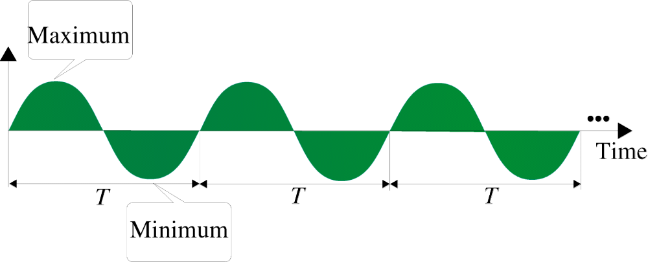
Figure : A simple sine wave

Slide 23
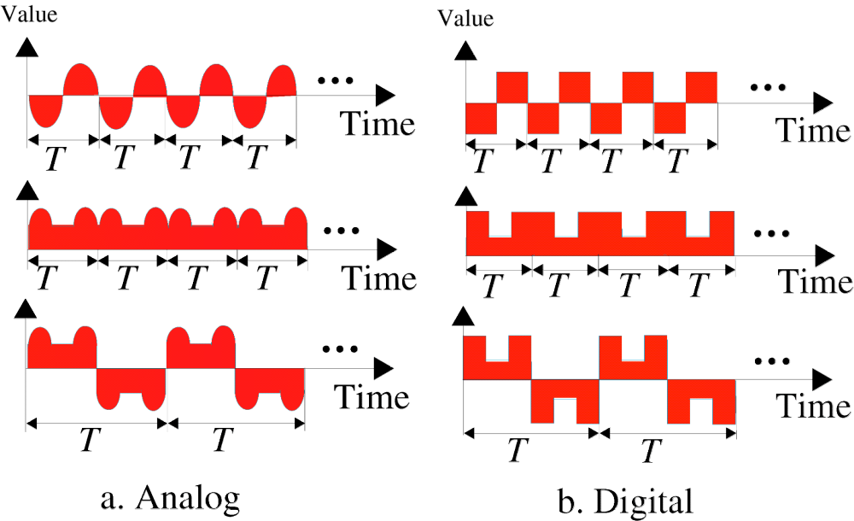
periodic analog signal and digital
Figure : Sine wave

Slide 24
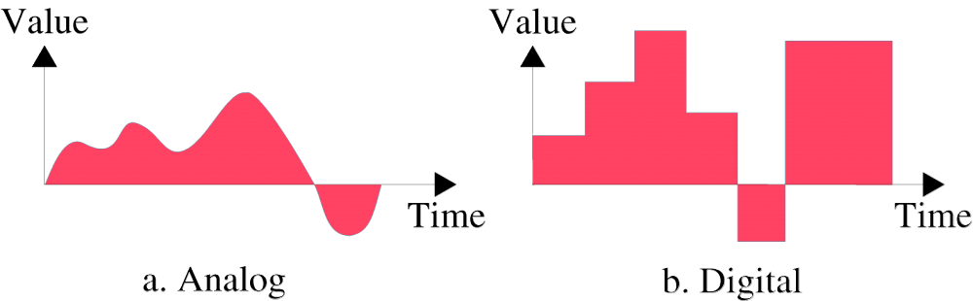
Figure : Non-periodic (Aperiodic) Signal

Slide 25
5) Signal Parameters
A sine wave can be represented by three parameters :the peak amplitude ,the frequency and the phase. These three parameters fully describe a sine wave.
Peak amplitude
The peak amplitude of a signal is the absolute value of its highest intensity ,proportional to the energy it carries .For electric signals ,peak amplitude is normally measured in volts.

Slide 26

Figure : Two signals with same frequency and phase but different amplitudes
Example:

Slide 27
Period and Frequency
Period refers to the amount of time ,in seconds ,a signal needs to complete one cycle. Period is formally expressed in seconds.
Frequency refers to the number of periods in 1 sec. Frequency is formally expressed in Hertz (Hz),which is cycle per second.
Period is the inverse of frequency ,and frequency is the inverse of period ,as the following formula show.
f = 1/T and T = 1/f

Slide 28

Figure : Two signals with the same amplitude and phase ,but different frequencies.

Slide 29
Phase
The term phase describes the position of the waveform relative to time 0 .Phase is measured in degree or radians.
A phase shift of 360 degree corresponds to a shift of a complete period ,a phase shift of 180 degree corresponds to a shift of one-half of a period ,and a phase shift of 90 degree corresponds to a shift of one-quarter of a period.

Slide 30

Figure : Sine waves with same amplitude and frequency but different phases

Slide 31
Wavelength
Wavelength is another characteristics of a signal travelling through a transmission medium .
Wavelength is defined as the distance from a particular height on the wave to the next spot on the wave where it is at the same height and going in the same direction.
Wavelength binds the period or the frequency of a simple sine wave to the propagation speed of the medium.
Wavelength = Propagation speed* period = Propagation speed/frequency

Slide 32
Figure : Wavelength
Wavelength

Slide 33
Composite Signals
A single frequency wave is not useful in data communication . We need to send a composite signal.
In the early 1990s ,the French mathematician Jean-Baptiste Fourier showed that any composite signal is actually a combination of simple sine waves with different frequencies ,amplitudes and phases.
A composite signal can be periodic or non-periodic.
A periodic composite signal can be decomposed in to a series of simple sine waves with discrete frequencies(frequencies that integer values like 1,2,3,and so on)
A non-periodic composite signal can be decomposed in to a combination of an infinite number of simple sine waves with continuous frequencies ,frequencies that have real values.

Slide 34
Bandwidth
The bandwidth of a composite signal is the difference between the highest and the lowest frequencies contained in that signal.
Example
If a periodic signal is decomposed in to five sine waves with frequencies of 100 ,300 ,500,700 and 900 Hz .Then the bandwidth is 800 Hz.

Slide 35
Digital Signals
In addition to being represented by an analog signal ,information can also be represented by a digital signal.
For example a 1 can be coded as a positive voltage and a 0 as a zero voltage.
A digital signal can have more than two levels. In this case we can send more than 1 bit for each level.
Figure : shows two signals ,one with two signal levels and the other with four signal levels.

Slide 36


Slide 37
Another term –bit rate (instead of frequency)-is used to describe digital signals.
The bit rate is the number of bits sent in 1 sec ,expressed in bits per second(bps).
The bit length (instead of wavelength) is the distance one bit occupies on the transmission medium.

Slide 38
6) Channel Effects on Transmission :Transmission Impairment
Signals travel through transmission media, which are not perfect. The imperfection causes signal impairment. This means that the signal at the beginning of the medium is not the same as the signal at the end of the medium. What is sent is not what is received. Three causes of impairment are attenuation, distortion, and noise.
Attenuation means loss of energy.
Distortion means that the signal changes its form or shape.
Noise is another cause of impairment ,may corrupt the signal.

Slide 39

Figure 3.26 Attenuation (the first impairment)
3.<number>

Slide 40

Figure 3.28 Distortion (the second impairment)
3.<number>

Slide 41

Figure 3.29 Noise (the third impairment)
3.<number>

Slide 42
Signal-to-Noise Ratio(SNR)
The signal-to-noise ratio is defined as SNR = average signal power
average noise power
SNR is actually the ratio of what is wanted (signal) to what is not wanted (noise).
A high SNR means the signal is less corrupted by the noise ,a low SNR means the signal is more corrupted by the signal.
Because SNR is the ratio of two powers ,it is often described in decibel units ,SNR_{db} = 10 log₁₀ SNR

Slide 43

Figure 3.30 Two cases of SNR: a high SNR and a low SNR
3.<number>

Slide 44
Noiseless Channel : Nyquist Bit Rate
For a noiseless channel ,the Nyquist bit rate formula defines the theoretical maximum bit rate
BitRate = 2*bandwidth *log₂L
Where bandwidth is the bandwidth of the channel ,L is the number of signal levels used to represent data ,and BitRate is the bit rate in bits per second.
Increasing the levels of a signal may reduce the reliability of the system.

Slide 45
Noisy channel :Shannon Capacity
In 1994 ,Claude Shannon introduced a formula called the Shannon Capacity ,to determine the theoretical highest data rate for a noisy channel
Capacity = bandwidth*log₂(1+SNR) ,where bandwidth is the bandwidth of the channel ,SNR is the signal-to-noise ratio ,and capacity is the capacity of the channel in bits per second.
The Shannon capacity gives us the upper limit; the Nyquist formula tells us how many signal levels we need

Slide 46
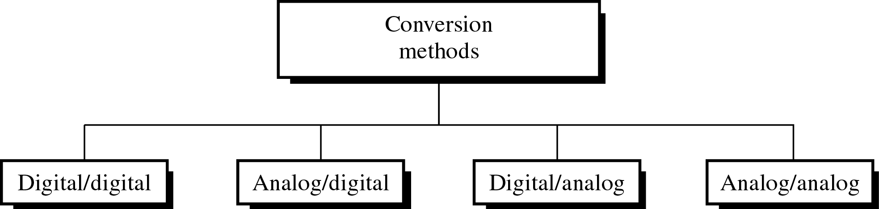
4) Conversion Techniques (Encoding)
Different conversion schemes

